Slide 1
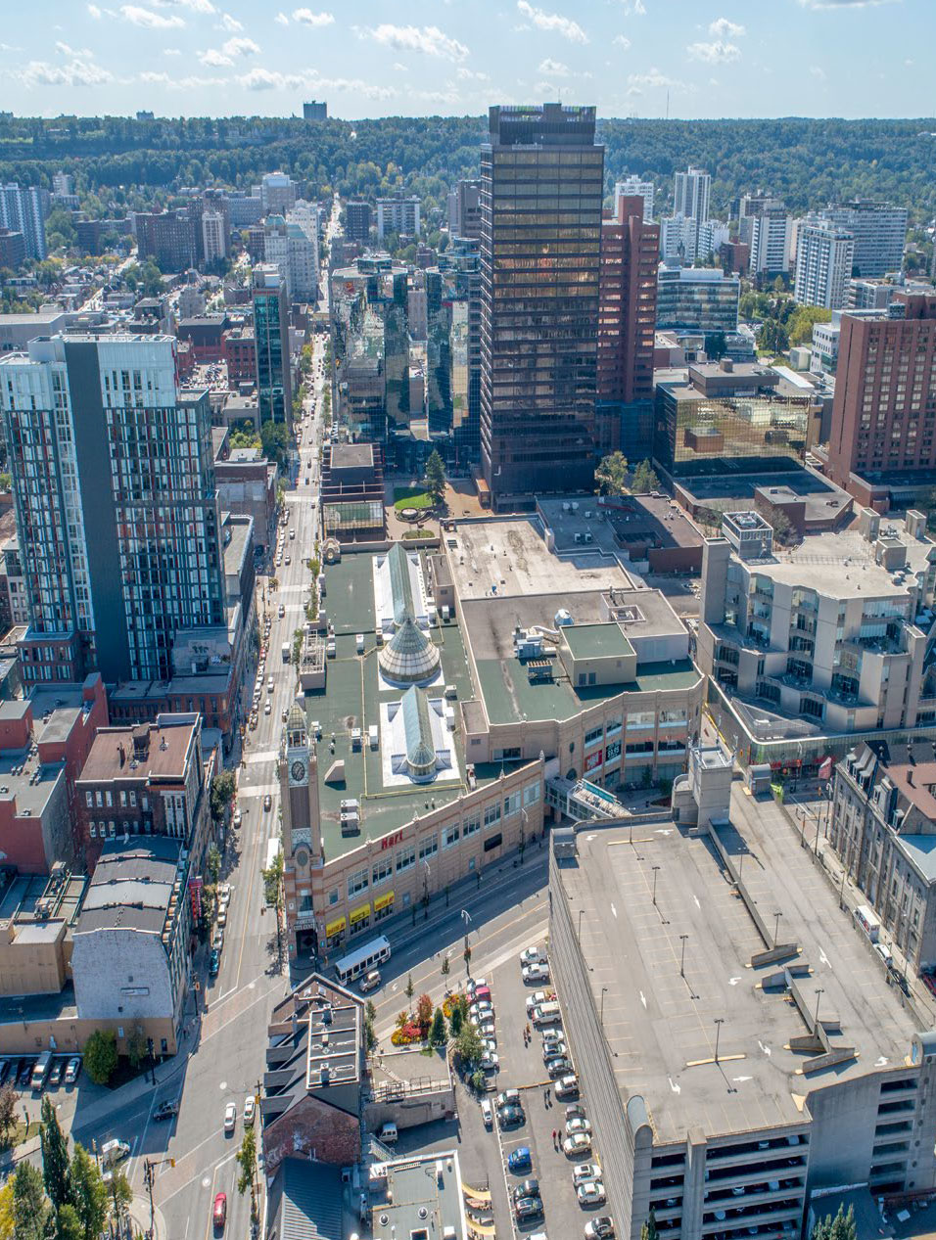

PARCC
We got your spot
Notes:
http://cbrecanada.com/hamiltoncitycentre/wp-content/uploads/2018/10/Hamilton-city-centre4.jpg

Slide 2




David Murga
Computer Engineering
B.Eng
Cameron Macdonald
Chemical & Biomedical
B.Eng.BME
About Us
We are 3 engineering students spanning 3 different disciplines
Ryan Tong
Chemical & Bioengineering
B.Eng
Your company name

Slide 3
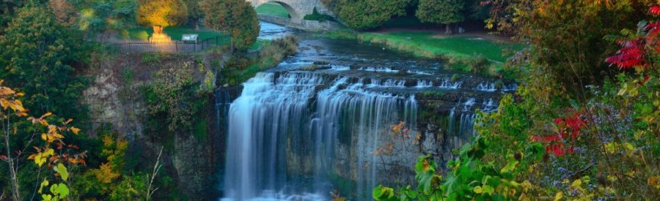

Problem definition
Huge variety of activities in Hamilton!
What do I pick?

Slide 4
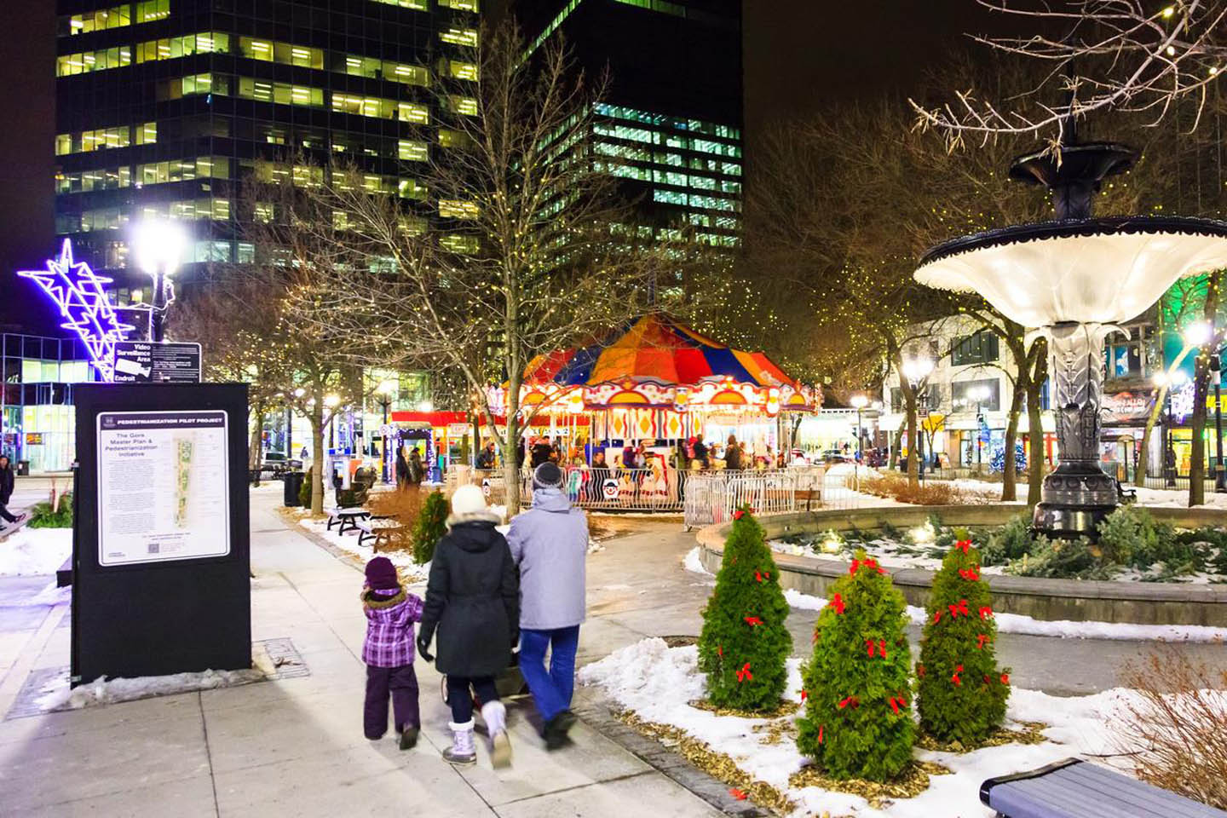
Significance
Activities
Weather
Hamilton is famous for waterfalls and trails
Has a huge variety of under-utilized indoor activities
Market research from tourism Hamilton suggests a requirement for identifying a ‘needs’ periods routing
Average rainfall of 835mm
Average summer temperature of 27 Celsius
Average winter temperatures around 0-2 Celsius
Notes:
https://tourismhamilton.com/wp-content/uploads/2015/06/HamiltonTourismStrategy2015.pdf

Slide 5
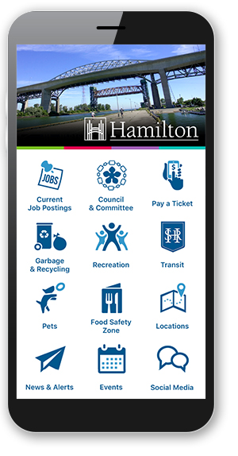
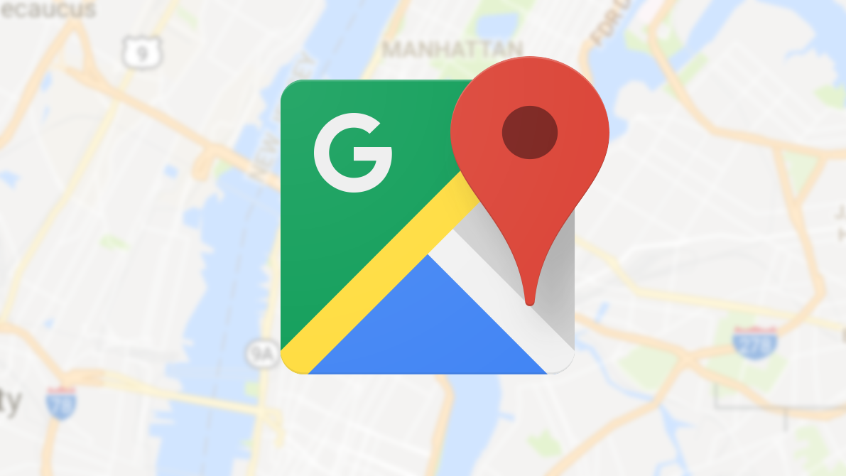
Other Solution
Google Maps
Hamilton City App
Provides a wealth of information on nearby locations
Does not collect weather data
Provides a wealth of information on nearby locations
Information not personalized

Slide 6
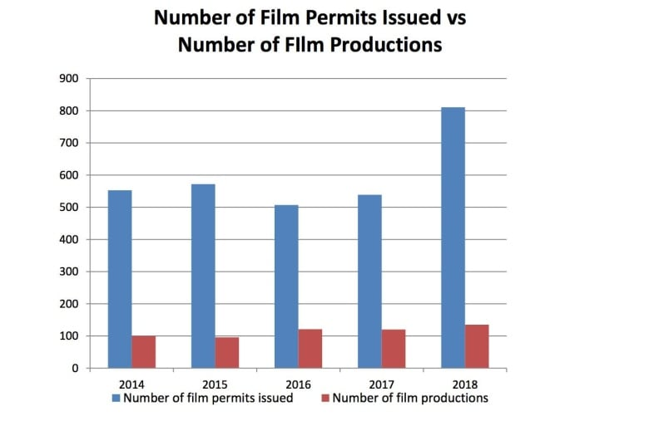
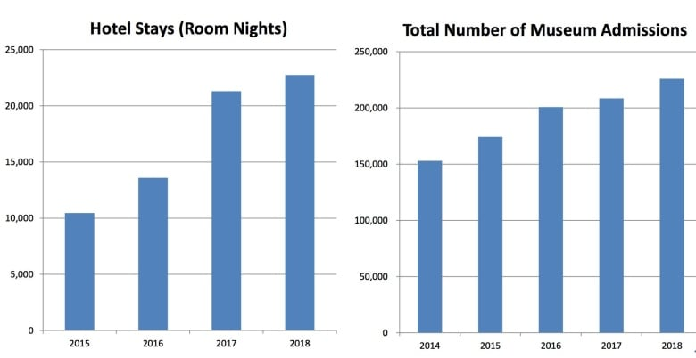
Market
4.5 million tourists in 2018
$360 million dollars in spending
Projected grow over the next decade due to increase in film industry

Slide 7
Solution
Vision
A fully integrated Hamilton tourism app that conveys the following in real time:
Personalised activity suggestions based on weather and location data
Display maps information to chosen locations
Direct users to the location

Slide 8
Business model
Value Proposition
Competitive Advantages
Customer Relationship
User friendly, intuitive interface
Saves time and stress
Helps to increase tourism
Streamlined, integrated,
Offers personalised information based on more data than the competition
Main customer – tourists/locals
Team responsive to feedback
City of Hamilton
Revenue Streams
Cost Structure
In-app advertisements
Sponsorships
Activity data for City of Hamilton
Fixed cost – initial $25 development fee
Variable cost – app maintenance, data collection

Slide 9
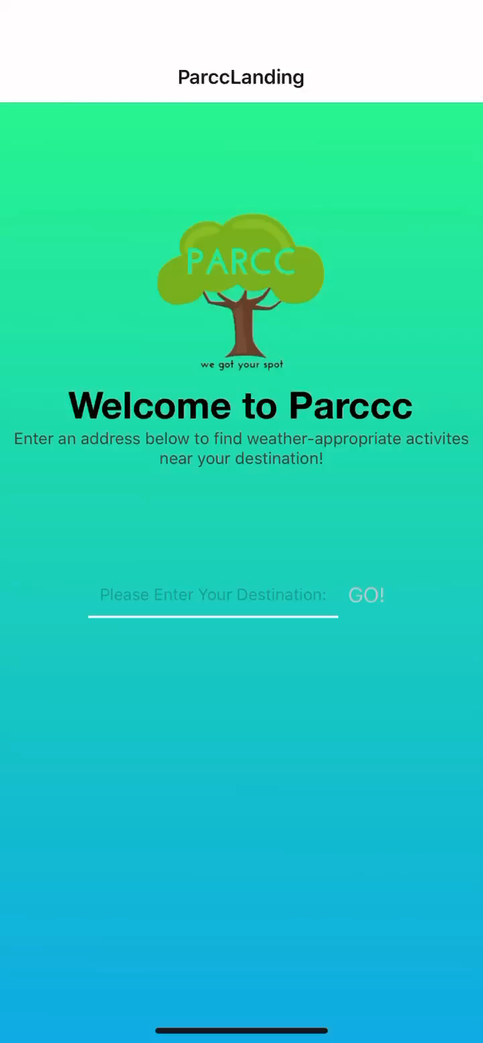
Demo
Takes in an address
Provides activity options based on the weather and the location inputted by the user
Links the users to maps, where they navigate to the location
Includes information on
Arenas, Beaches, Campgrounds, City Waterfalls, , Live Music Venues, Museums, Galleries, Community Centres, Spray Pads and more!

Slide 10


S t a c k
Front End
React Native
Redux for state management
Sagas & AXIOS for API calls
Back End
Python & Numpy for data collection and analysis
Google Maps and Dark Sky API for location and weather information
AWS Beanstalk and Route 53 for endpoint
Misc
Hamilton Public APIs
Dark Sky Weather API
Google Maps API

Slide 11
Questions?

Slide 12
Thank you!

